Slide 1
Natural Language Processing
Group: Alec Moore, Tommy Glasser
Class: CS457 Artificial Intelligence
Instructor: Susan Mabry
Date: 4/22/14

Slide 2
What is Natural Language Processing? (NLP)
Interactions and behaviors between computer and human languages
Subcomponent: Natural Language Understanding
Reading comprehension, purpose
Common spoken and textual/interactive systems:
Making reservations, navigation systems, interactive virtual agents
Rest of the presentation:
Structure of NLP: How it works
Goal, challenges, addressing the problems
Future of NLP

Slide 3
Syntax and Formal Grammar
Morphology
The form and structure of a word and its relationship to roots and derivations
Syntax
How words are put together to form phrases or sentences
Semantics
The study of meaning in language
Parsing
Breaking down a sentence down into its component parts of speech ”with an explanation of the form, function and syntactical relationship of each part"
Lexical
Relating to the vocabulary, words or morphemes of a language
Pragmatics
The use of language in context, and ellipsis, omission of portions of sentences that are not necessary.

Slide 4
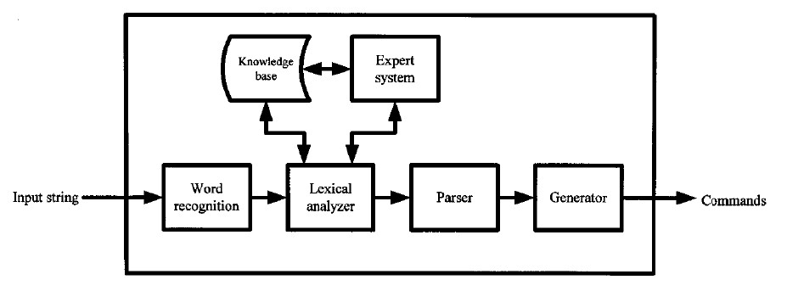
A look into the structure

Slide 5

Example: InteliWISE

Slide 6
Implementation
Developing the “Brain”

Slide 7
Problems and Limitations
Goal of NLP
Analyze, understand and generate language that humans use naturally
Problems
What it means to “understand”
Consider concepts, words, phrases, purpose, context, and so forth
i.e.: Microsoft Research: “Flying is dangerous”… to whom?, vague questions, moral questions
Exposure to experience
Understanding context and intent
Grammar
Pronunciations
i.e: “Since there is no time like the present, he thought it was time to present the present”

Slide 8
Addressing the Problem
Statistical machine learning a.k.a Statistical NLP
Large amounts of research and money investment towards topics such as:
Machine translation
Named entity recognition
Natural language generation
Natural language understanding
Parsing accuracy

Slide 9
Findings
NLP is very difficult and challenging to implement
We implemented just a few commands and prompts for Ferdinand, already taking some time and research
Large databases are needed to process language in terms of semantics, syntax, meanings
Machines lack experiences with linguistic structure and knowledge of real world, limited to only what humans know
Strong vs weak AI

Slide 10
References
1. Lucci, Stephen, and Danny Kopec. Artiﬁcial Intelligence in the 21st Century. Dulles: Mercury Learning and Information LLC, 2013. 398-400,405,410,421. Print.
2. Davis, William S., and David C. Yen. The Information System Consultant’s Hand- book: Systems Analysis and Design. Boca Raton: CRC Press LLC, 1998. Web. <http://www.hit.ac.il/staff/leonidM/information-systems/ewtoc.html>.
3. ”Natural Language Processing.” Microsoft Research. Microsoft, n.d. Web. 21 Apr 2014. <http://research.microsoft.com/en-us/groups/nlp/>.
4. Wikipedia contributors. ”Natural language processing.” Wikipedia, The Free Ency- clopedia. 24 March, 2014. <http://en.wikipedia.org/wiki/Natural_language_ processing>.
5. Nusca, Andrew. ”Say Command: How Speech Recognition Will Change the World.” SmartPlanet. SmartPlanet. Web. 21 Apr 2014. <http://www.smartplanet.com/ blog/smart-takes/say-command-how-speech-recognition-will-change-the-world/ >.

